Slide 1
A CNN for the Automatic Diagnosis of Collagen VI related Muscular Dystrophies
CS 732 Presentation 1
Jiali Wang

Slide 2
Introduction
Background
The importance of this problem
What has been done already
The contributions of the authors
Methods
Method descriptions
Results
Data summary
Method comparison
Accuracy measure

Slide 3
Background
A challenge of machine learning to diagnose rare diseases:
Lack of data
The paper proposed a solution for this issue:
Use Computer Aided Diagnosis (CAD) and Convolutional Neural Network (CNN) to classify for non-overlapping patches tilting the confocal microscopy input images related to low-prevalence, congenital muscular dystrophies
Can generate a summarized decision from individual decision from each image patch

Slide 4
Lack of collagen VI usually leads to neuromuscular diseases such as Bethlem myopathy and Ullrich congenital muscular dystrophy.
The symptom is detrimental to one’s health, which even may result in a reduced live span.
It’s related to gene mutations, primarily COL6A1, COL6A2, and COL6A3, OMIM 254090 and 158810
A possible solution lies in gene edition, with the progress of genome editing tools. However, rare disease diagnosis still remains challenging.
The article focuses on resolving the challenge in evaluating efficiency of therapeutic ways during the recovery of collagen VI network.

Slide 5
Typical symptoms of this disease
proximal and axial muscle weakness
distal hyperlaxity
joint contractures
critical respiratory insufficiency that leads to reduced life span in estimation
a rare disease—lack of data

Slide 6
Statistics of frequency
“Collagen VI-related myopathy is rare. Bethlem myopathy is estimated to occur in 0.77 per 100,000 individuals, and Ullrich congenital muscular dystrophy is estimated to occur in 0.13 per 100,000 individuals. Only a few cases of the intermediate form have been described in the scientific literature.”—U.S. National Library of Medicine

Slide 7
Introduction
Background
The importance of this problem
What has been done already
The contributions of the authors
Methods
Method descriptions
Results
Data summary
Method comparison
Accuracy measure

Slide 8
Poses a dilemma of current treatments
Current disease evaluation method:
Specialist’s visual evaluation that is only qualitative, such as orientation of the collagen fibers, the regularity of the collagen network, and the arrangement of cells in such network.
Treatment will not be approved without objective proof.
There is a dire need of quantitative method for new therapy development.
The paper presents a computer aided diagnosis (CAD) system implemented by Convolutional Neural Network (CNN) classifier for dystrophies related to defective collage VI.

Slide 9
Introduction
Background
The importance of this problem
What has been done already
The contributions of the authors
Methods
Method descriptions
Results
Data summary
Method comparison
Accuracy measure

Slide 10
Works done by others
2 major steps of automated analysis in medical image analysis:
Feature extraction from images
Features are evaluated in a function/classifier
Many feature extraction techniques perform inadequately in identifying the disease image, including multi-scale Gaussian filterbank¹, PCA², Localy Binary Patterns (LBP)³, completed LBP⁴, gray-level co-occurrence matrices⁵ and Artificial Neural Networks (ANNs)⁶.
The challenge lies in relevant feature selection.
There is not any single method can provide satisfactory identification here.

Slide 11
Non-parametric approaches and CNNs yield the best results in identification of histopathological breast cancer images that is similar to images discussed in the paper.
CNNs stem from ANNs, but differ from the latter in the following aspects:
They remain fixed in image translation.
Some layers also help fix translation variance.
Another advantage of CNNs (why they are adopted in this paper):
They can directly perform on images, unifying both identification and classification.
The CNN is trained by labels provided by specialists.
A patch-based data augmentation technique is proposed here, owing to the lack of rare diseases cases (training data).

Slide 12
Introduction
Background
The importance of this problem
What has been done already
The contributions
Methods
Method descriptions
Results
Data summary
Method comparison
Accuracy measure

Slide 13
Allows diagnosis of muscular dystrophies even with the lack of data
Helps monitor efficiencies of various treatments for the rare disease
Lessens burdens of medical expert
Solves the aforementioned dilemma

Slide 14
Introduction
Background
The importance of this problem
What has been done already
The contributions of the authors
Methods
Method descriptions
Results
Data summary
Method comparison
Accuracy measure

Slide 15
Introduction of CNNs
A CNN consists of some ordered layers with computational elements(neurons) which are pre-defined and fixed.
Different weights are assigned to the learning functions.
There are usually three kinds of layers in a CNN:
Convolutional
Pooling
Fully connected

Slide 16
Convolutional
Usually to deal with squared areas, resulting in a feature map Y
Kernel:
$$y=\sum_{n=1}^{N}{I_{n}k_{n}}$$
I_{n} is a pixel in the image
k_{n} is n-th kernel weight
N is the kernel size, i.e. the amount of pixels in the image affected by the kernel

Slide 17
Kernel output is realized by an activation function.
In this case, the activation function is a non-negative rectified linear unit (ReLU).
$$f\left(x\right)=\left\{\begin{aligned}0, x<0 \\ &x, x≥0\end{aligned}\right.$$
Kernel stride:
The horizontal/vertical distance in pixels between the centers of two consecutive kernels.
Strides larger than 1 are likely to downsample a feature map.

Slide 18
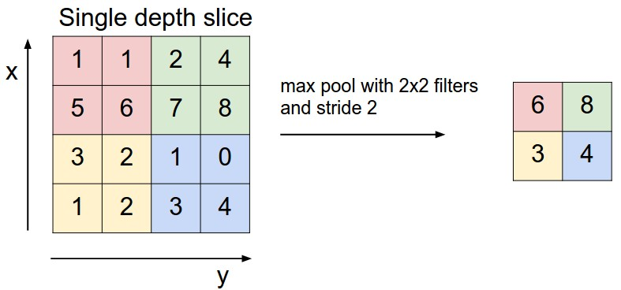
Pooling Layers
pooling layers down-sample the input by summarizing a patch in the image with a single value.
The URL of this pictorial presentation is from:
https://www.google.com/search?rlz=1C1CHBF_enUS826US826&biw=1280&bih=530&tbm=isch&sa=1&ei=UtVoXNfIJce4ggfp9LigBg&q=pooling+layer&oq=pooling+layer&gs_l=img.3..0j0i67j0i5i30l2j0i24l6.3962.5943..6251...0.0..0.88.906.13......1....1..gws-wiz-img.......35i39j0i10j0i5i10i30j0i8i30.mYmV0HQqKmk#imgrc=_qdiQ0Wq2sQCiM:

Slide 19
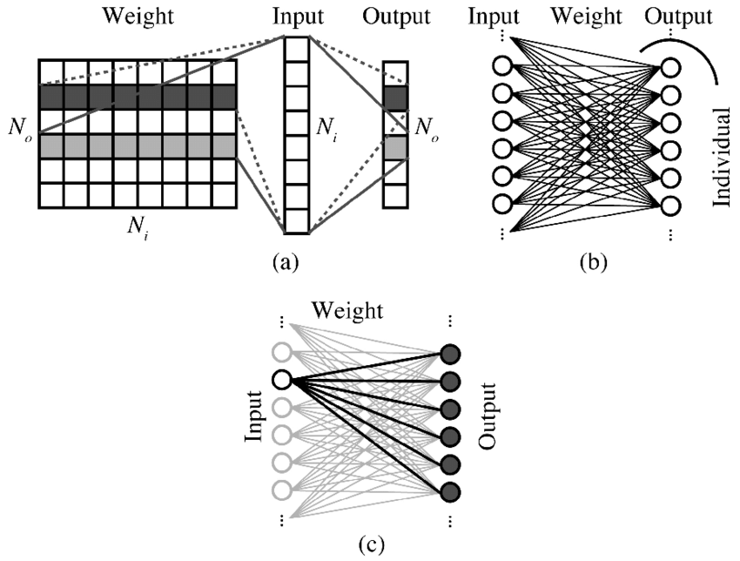
Fully-connected Layers
Usually occurred at the end of CNN, and decides the classification via an activation function.
In this case, it’s characterized by the sigmoid function
$$σ\left(x\right)=\frac{1}{1+ⅇ^{−x}}$$
x is a weighted sum of inputs
the output is a number between 0 and 1.
Image from: https://www.google.com/search?rlz=1C1CHBF_enUS826US826&biw=1280&bih=530&tbm=isch&sa=1&ei=WtVoXIm4C-SGggeM_5qADA&q=Fully-connected+Layers%0B&oq=Fully-connected+Layers%0B&gs_l=img.3..0i30.292981.292981..294016...0.0..0.64.64.1......1....2j1..gws-wiz-img.gEAKbGlj-sc#imgrc=VLQFgxGR-ZG4NM:

Slide 20
Combination of the all three
Image from:
https://www.google.com/search?rlz=1C1CHBF_enUS826US826&tbm=isch&q=Fully-connected+Layers+&chips=q:fully+connected+layer,g_1:convolutional+neural+network:czk5zNyplQY%3D&usg=AI4_-kTaHo5a8WV83uK4jEfGmIsWd5Aaog&sa=X&ved=0ahUKEwi0wO2Y68HgAhUpU98KHf5HC-sQ4lYIKCgA&biw=1280&bih=530&dpr=1.5#imgrc=5MXH4b48-olmkM:

Slide 21
It’s better to make o_{i} and t_{i} as similar as possible for each input i.
The goal is to minimize the error
$E=\frac{1}{2}\sum_{i=1}^{n}{||o}$_{i}(W)-t_{i} $||$²
W is the weights in the CNN determining the output.
weights are initialized with random values and are updated with a gradient descent rule
$α$ is the learning rate deciding the gradient descent intensity
$$w=w−α\frac{∂E}{∂w}$$

Slide 22
CNN training process by backpropagation
Forward pass:
computes neuron activation
Error backpropagation:
use the difference between the output and ground-truth to calculate error gradient in terms of weights W₁ and W₂.
W₁ and W₂ can be calculated by gradient descent

Slide 23
Training and Evaluation
Training set
80% training data and a test set
Epoch
The iteration over all the available training set
A validation set having 10% of the training data will be used for performance evaluation of CNN after each epoch.
The CNN generalization capacity will be evaluated by the test set not used for training.

Slide 24
Overfitting Solutions
The evaluation with a validation and a testing set
Dropout
Some neurons have a certain chance to be deactivated, which is equivalent to removal from the CNN.
This helps improve robustness against weight sensitivity.

Slide 25
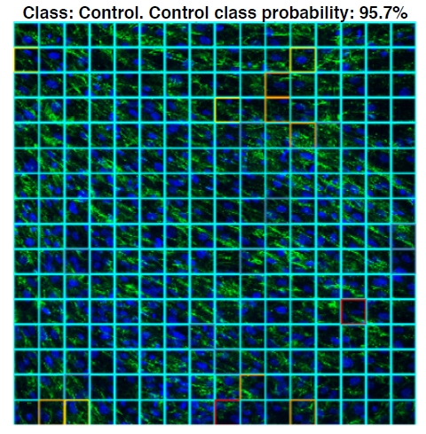
Visualization in Automatic Diagnostic System
Each tile has a probability of color related to the control class.
In this example, 95.7% of the patches are classified to the control in the image. It also tracks the evolution of a patient and can tell if a treatment is effective or not.

Slide 26
the Proposed CAD System
Module 1
Input: a full image
Output: non-overlapping patches of 64x64 pixel size
Module 2
Formed by CNN classification model
Input: patches from Module 1
Output: prediction of each patch
Module 3
Input: local decisions for each patch
Output: a global decision for majority voting
Module 4
visualizes the input image, the decision for each patch represented in a color code, and the overall decision of the system

Slide 27
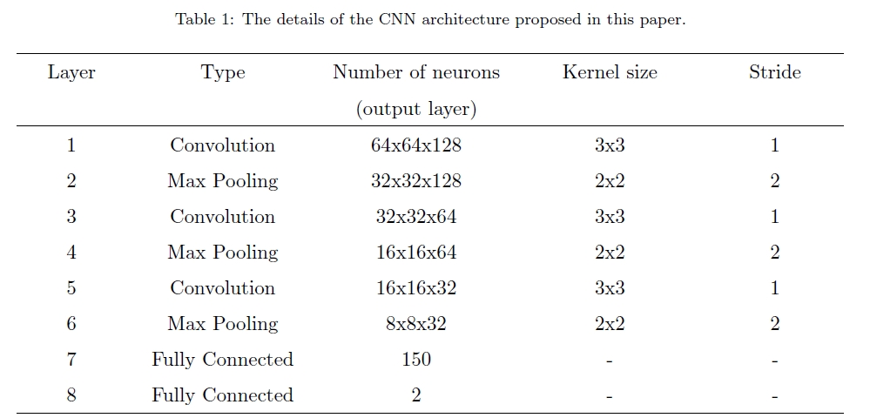
Proposed CNN Architecture in Detail

Slide 28
Variables
Size of the network (with small/large number of convolution kernels)
Abstraction level (with increasing/decreasing sizes of the subsequent layers of the CNN)
Empirically, small CNNs with decreasing feature numbers win out.
There’s a diminishing return. Many low level features are learned in first level, while few high level features are learned in subsequent levels.

Slide 29
Normalization: to have 0 mean and unit variance. It prevents premature convergence and facilitates gradient descent process. Implemented in Convolutional Layer 1, 3 and 5.
Max pooling layers: Lead to size reduction with a stride of 2. Correspond to Layer 2, 4 and 6.
Fully connected layers: implemented for classification. Correspond to Layer 7 and 8.
Layer 7: has 150 neurons, also followed by a ReLU activation function trained with a dropout mechanism with probability 0.5.
Layer 8: has 2 neurons whose output is truncated into a single binary output by a sigmoid activation function to provide the final classification.

Slide 30
Introduction
Background
The importance of this problem
What has been done already
The contributions of the authors
Methods
Method descriptions
Results
Data summary
Method comparison
Accuracy measure

Slide 31
Data acquisition and enhancement
Samples
from patients with aged-matched controls.
Primary fibroblasts cultures
Standard procedures⁷
Confluent fibroblasts
treated with 25 g/mL of L-ascorbic acid phosphate magnesium (Wako
Chemicals GmbH, Neuss, Germany) for 24 hours.
Collagen VI
detected by indirect immunofluorescence using a monoclonal antibody (MAB1944, Merck, Germany)
fibroblast nuclei
stained using 4,6-diamidino-2-phenylindole (Sigma Chemical, St. Louis, USA).

Slide 32
Images:
a Leica TCS SP8 X White Light Laser confocal microscope with hybrid
spectral detectors (Leica Microsystems, Wetzlar, Germany).
Collagen VI
Excited with an argon laser (488 nm) and detected in the 500-560 nm and nuclei were excited with a blue diode laser (405 nm) and detected in the 420-460 nm.
Sequential acquisition settings
used to avoid inter-channel cross-talk.
Enhanced data scheme
From other’s enlightment⁸
Data augmentation
Split a full image into many small, non-overlapping patches which serve as an independent CNN model input individually

Slide 33
Input image volume
1024x1024
256 patches per image
(8 variation for each patch) 90, 180, 270 and 360 degree rotation + horizontal flip
Each input generates 2048 training inputs
Overall 56320 and 14336 patches, excluding the rotated and mirrored patches.

Slide 34
Confusion matrix of the test set (64x64 patches)
64x64 size were adopted, as it’ a particular relevant window size for CNN classification models⁹
The patches in this case mostly succeed in sketching main features of the image.

Slide 35
Implementation system information
Python
Keras 2.2 Library with TensorFlow 0.19
A workstation
CPU: Intel Core i7-7700HQ
RAM: 16 GB
GPU: NVIDIA GeForce GTX 1050
Batch size: 32
Less than 10 epochs for convergence
Adam optimizer¹⁰
Learning rate α = 0.01
Exponential decay rates β₁ = 0.9, β₂ = 0.999, ε = 10⁻⁸

Slide 36
Results
Level 1
per-patch performance of the CNN model
Level 2
performance of the proposed system on full images
By this approach we can evaluation model performance by local features (patches) and see their integration as a global decision (full images).

Slide 37
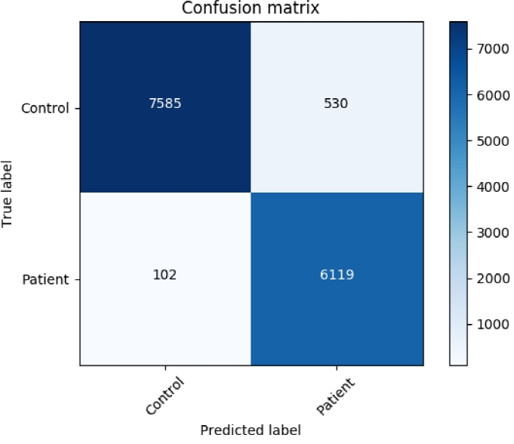
the amount of patches correctly and incorrectly classified as belonging to the control class are in the first row. From a total of 8115 control patches in the test set, 7585 are true negatives (TN), i.e., the inputs correctly classified as control and 530 are false positives (FP), i.e., the inputs incorrectly classified as patient. The classification of patients is given in the second row, where, 102 are false negatives (FN), i.e., the inputs incorrectly classified as control, and 6119 are true positives (TP), i.e., the inputs correctly classified as patient. In the majority voting system the accuracy is perfect and, thus, the confusion matrix is trivial and not given here.

Slide 38
Introduction
Background
The importance of this problem
What has been done already
The contributions of the authors
Methods
Method descriptions
Results
Data summary
Method comparison
Accuracy measure

Slide 39
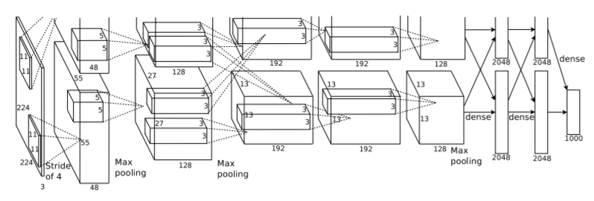
ImageNet Classification with Deep Convolutional Neural Networks
Both papers use ReLu activation function and 8 layers. However, the second paper seems to have much larger input volume in each layer.
Both papers propose data augmentation and dropout to overcome overfitting.
Both papers suggest normalization for data cleaning.
Neither is computationally demanding, however, the second one has two GPUs running parallelly (GTX 580 X 2 vs GTX 1050 Mobile).

Slide 40
The second paper stated that ReLu is much more efficient than the f(x) = tanh in a convolutional neural network, resulting in significant performance boost (6 times faster) with 25% training error in CIFAR-10. There is not any regularization.
Additionally, it also performed PCA on the set of RGB pixel values throughout the ImageNet training set, which resulted in a reduction of the top-1 error rate by over 1%.

Slide 41
Introduction
Background
The importance of this problem
What has been done already
The contributions of the authors
Methods
Method descriptions
Results
Data summary
Method comparison
Accuracy measure

Slide 42
Performance evaluation metrics
Accuracy(A): the correct classification rate, defined as the ratio of correctly classified cases with respect to the total number of cases.
$$A=\frac{t_{p}+t_{n}}{t_{p}+t_{n}+f_{p}+f_{n}}$$
Precision(P): the ratio of inputs correctly classified as patient with respect to the total number of inputs (correctly or incorrectly) classified a patient.
P$=\frac{t_{p}}{t_{p}+f_{p}}$
Recall(R): the ratio of samples correctly classified as patient with respect to total inputs that are actually in the patient class.
R$=\frac{t_{p}}{t_{p}+f_{n}}$
F₁ metric: the weighted harmonic mean of precision and recall.
F₁=$\frac{2PR}{P+R}$

Slide 43
The performance of the proposed system
The patch with 64x64 size shows excellent results in terms of all metrics.
The image with 1024x1024 size even shows perfect results in all dimensions.

Slide 44
CNNs provide highly accurate results, while they remain to be black boxes due to difficulty in knowing classification and feature criteria.
Left:
An image patch visualization which illustrates how each pixel contributes to control class in classification. The network focuses on the fibroblast nuclei and on the regions without collagen VI.
Right:
A saliency map related to control class. What it lacks in intensity, it makes up for in extension. The red area indicates pixels with high contribution in classification.

Slide 45
Another saliency map about activation visualization of each convolutional layer with respect to the patient class The saliency represents output gradient of a particular convolutional layer. The earlier layers only learn primary features such as the existence or lack of fibroblast or collagen VI. Deeper layers become more abstract and make it harder to implement image relevance.

Slide 46
Summary
The paper discusses a system as a solution to tackle with muscular dystrophies due to lack of collagen VI.
The proposed system depends on a deep CNN as well as a data augmentation scheme, in order to deal with the issue of lack of rare disease data.
In the experiment, the system has a perfect score in test set diagnosis, which makes it a decent tool to evaluate various therapies for patients with deficiency of collagen VI.
The saliency maps show how each pixel contributes to classification and feature learning by the CNN. This is helpful for primary feature discovery in CNN.
The authors attempt to extend the analysis by retrieving more abstract features and finding out other classification criteria.
Lastly, the authors are trying to apply the technique to other rare diseases relevant to lack of collagen VI or other extra-cellular matrix proteins.

Slide 47
References
1 A. M. Schilham, B. van Ginneken, M. Loog, A computer-aided diagnosis system for detection of lung nodules in chest radiographs with an evaluation on a public database, Medical Image Analysis 10 (2) (2006) 247-258.URL https://doi.org/10.1016/j.media.2005.09.003
2 M. M. Adankon, J. Dansereau, H. Labelle, F. Cheriet, Non invasive classication system of scoliosis curve types using least-squares support vector machines, Articial Intelligence in Medicine 56 (2) (2012) 99-107.URL https://doi.org/10.1016/j.artmed.2012.07.002
3 T. Ahonen, A. Hadid, M. Pietikainen, Face description with local binary patterns: Application to face recognition, IEEE Transactions on Pattern Analysis and Machine Intelligence 28 (12) (2006) 2037-2041.URL https://doi.org/10.1109/TPAMI.2006.244
4 Z. Guo, L. Zhang, D. Zhang, A completed modeling of local binary pattern operator for texture classi-cation, IEEE Transactions on Image Processing 19 (6) (2010) 1657-1663.URL https://doi.org/10.1109/TIP.2010.2044957

Slide 48
5 L.-K. Soh, C. Tsatsoulis, Texture analysis of SAR sea ice imagery using gray level co-occurrence matrices,IEEE Transactions on Geoscience and Remote Sensing 37 (2) (1999) 780-795.URL https://doi.org/10.1109/36.752194
6 A. Khatami, A. Khosravi, T. Nguyen, C. P. Lim, S. Nahavandi, Medical image analysis using wavelet transform and deep belief networks, Expert Systems with Applications 86 (2017) 190-198. URL https://doi.org/10.1016/j.eswa.2017.05.073
7 C. Jimenez-Mallebrera, M. Maioli, J. Kim, S. Brown, L. Feng, A. Lampe, K. Bushby, D. Hicks, K. Flanigan, C. Bonnemann, C. Sewry, F. Muntoni, A comparative analysis of collagen vi production in muscle, skin and fibroblasts from 14 Ullrich congenital muscular dystrophy patients with dominant and recessive col6a mutations, Neuromuscular Disorders 16 (9) (2006) 571-582.URL https://doi.org/10.1016/j.nmd.2006.07.015
8 A. Krizhevsky, I. Sutskever, G. E. Hinton, Imagenet classication with deep convolutional neural net-works, in: Proceedings of the 25th International Conference on Neural Information Processing Systems- Volume 1, 2012, pp. 1097-1105.URL http://dl.acm.org/citation.cfm?id=2999134.2999257

Slide 49
9 F. A. Spanhol, L. S. Oliveira, C. Petitjean, L. Heutte, Breast cancer histopathological image classication using convolutional neural networks, in: International Joint Conference on Neural Networks (IJCNN), 2016, pp. 2560-2567.URL https://doi.org/10.1109/IJCNN.2016.7727519
10 D. P. Kingma, J. Ba, Adam: A method for stochastic optimization, CoRR abs/1412.6980. arXiv: 1412.6980. URL http://arxiv.org/abs/1412.6980

Slide 50
Thank you

